Slide 1
Introductie in de informatica
Wednesday 24th January 2024

Slide 2
Agenda Problem Solving
Sets in C++

Slide 3

Uniqueness of Elements
Sets ensure that each element is unique. Duplicates are automatically ignored upon insertion.
This property makes sets ideal for tasks where uniqueness is crucial, such as maintaining unique identifiers or eliminating duplicate entries.

Slide 4
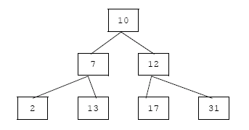
Binary Tree
As a result, elements in a set are always stored in a sorted order, which allows for efficient searching, insertion, and deletion operations.

Slide 5
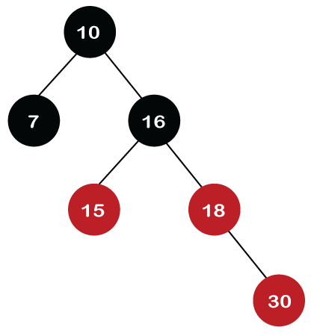
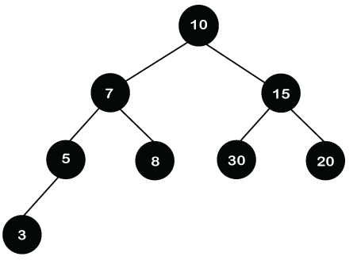
Red Black Tree
[10,7,15,5,8,30,20,3]
[10,7,16,15,18,30]

Slide 6
Insertion and Deletion
Elements can be easily inserted into and removed from a set using member functions like insert() and erase().

Slide 7
Iterator Support
Iterators provide flexibility in accessing, modifying, or iterating through the elements of a set.

Slide 8
Iterator
Iterator: In C++, an iterator is a special object that points to an element in a container, in this case, a set.
Dereferencing: When we use *it, we are dereferencing the iterator it. It means we are accessing the value that the iterator is pointing to.
Printing the Value: In the given loop, *it retrieves the value of the element that it is currently pointing to within the set. This value is then printed using std::cout.
Iteration: During each iteration of the loop, the iterator it moves to the next element in the set, and *it fetches the value of that element for printing.

Slide 9
Excercises
Create a Set of Numbers
Add and Remove Elements
Check Membership: For example, given the set {2, 4, 6, 8, 10}, check if 6 and 12 are present in the set.
Remove Duplicates

Slide 10
Vragen?

